Slide 1
Communicate Like a Boss: How to do it & why it works
October 11th, 2023
Presented to the Arvada Chamber of Commerce Leadership Boot Camp
By
Jay Voigt MBA, LPC, CAS, SHRM-CP

Slide 2
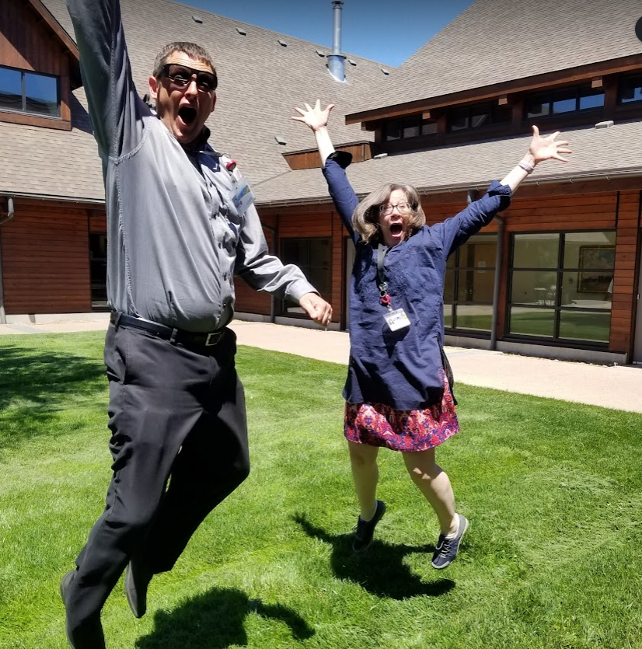
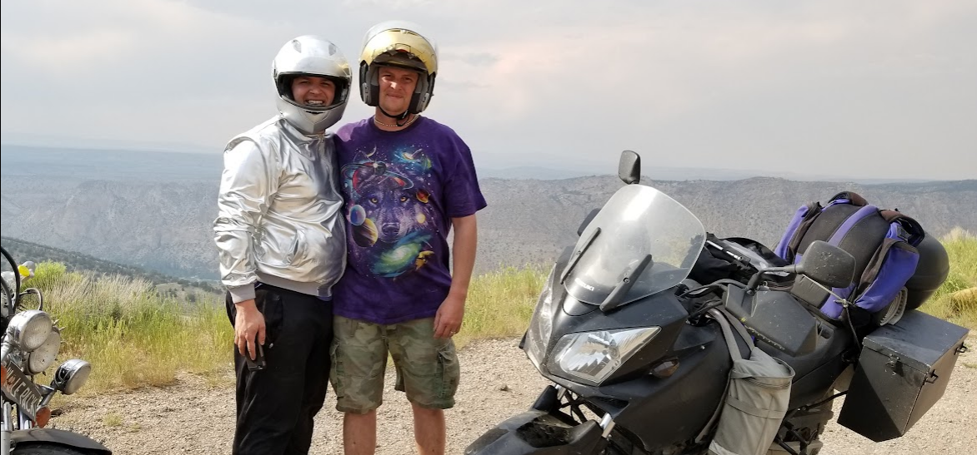
About me:
-20-year therapist & healthcare leader
-Built a career by investing in people
-Help organizations become workplace destinations
-Leader coaching, talent management, HR strategy

Slide 3
Agenda
Level setting- leading vs managing
Overview of communication types
Leadership communication practice
Q&A

Slide 4
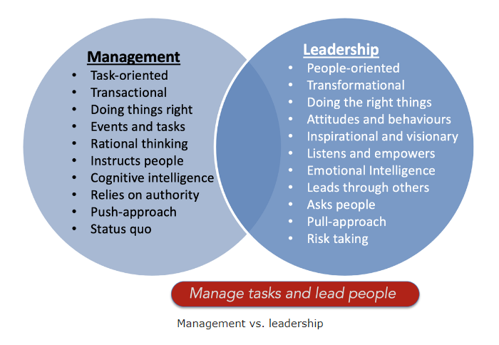
Level setting….
“There’s a significant difference between being in charge and being a leader” – Chris Adams

Slide 5
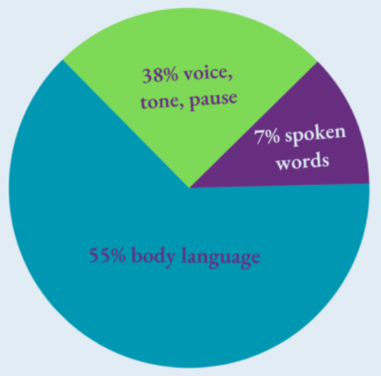
Mehrabian’s 7-38-55 Rule

Slide 7
The other kind of communication……..
What is not said
What is ignored
What is prioritized
What is acknowledged

Slide 8
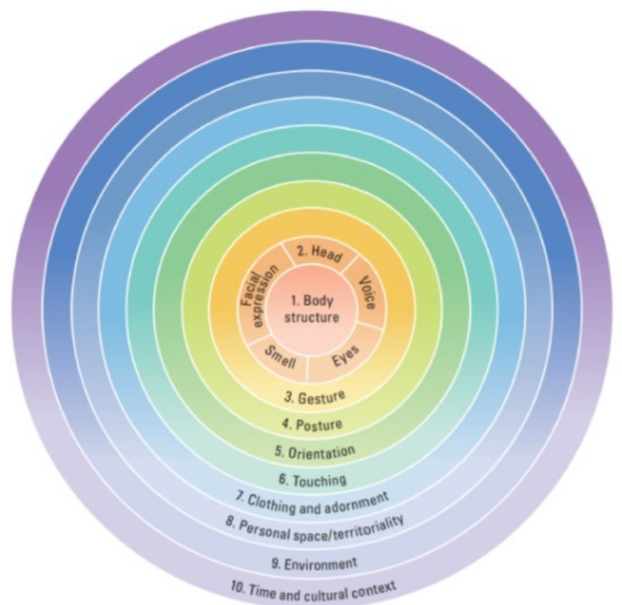
Nonverbal Communication
Most difficult
Hard to fake
Requires practice
Life experience/ state
Neuroscience

Slide 9
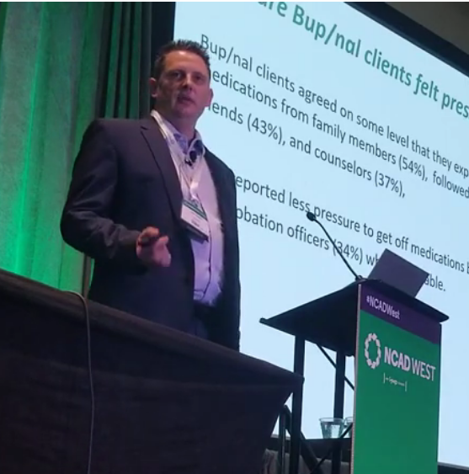
Verbal communication
Active listening
Know your audience
Be concise
Check for understanding
Focus on conversation
Volume & pace

Slide 10
Written Communication
Consider your audience
Be mindful of your tone
Proof it
Keep it professional
“If I had more time , I would have written you a shorter letter”- Mark Twain

Slide 11
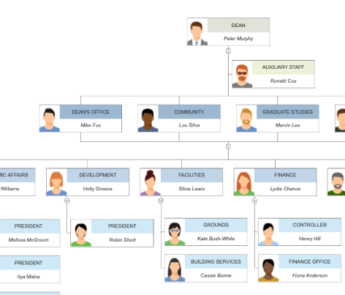
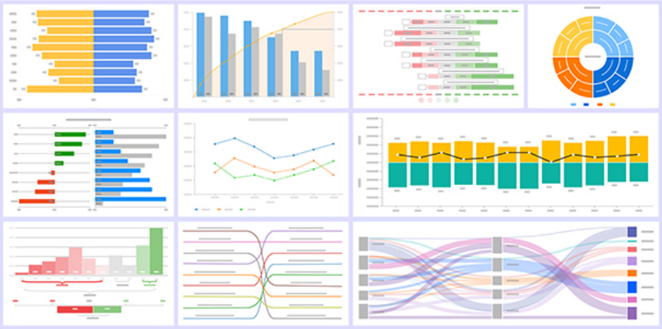
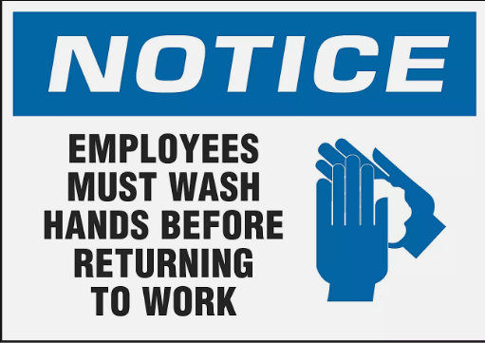
Visual Communication
Infographics
Metaphors/analogies
Data visualization
Storytelling

Slide 12
Practice: Giving feedback

Slide 13
How do great leaders communicate:
-Use short words to talk about hard things.
-Choose sticky metaphors to reinforce key concepts.
-Humanize data to create value
-Make mission your mantra to align teams

Slide 14
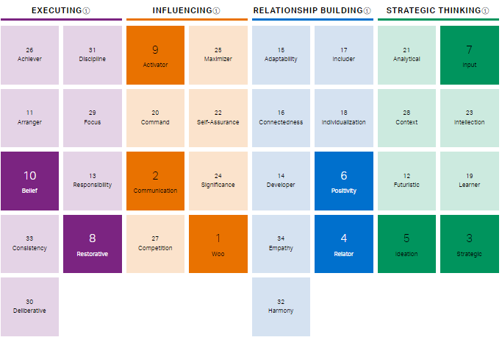
uman Capital LLC https://human-capitalllc.com/ Jay@human-capitalllc.com Cell: 720-587-7039
My Clifton Strengths:

